Slide 1
Chapter 7
Requirements Modeling: Flow, Behavior, Patterns, and WebApps
Slide Set to accompany
Software Engineering: A Practitioner’s Approach, 7/e
by Roger S. Pressman
Slides copyright © 1996, 2001, 2005, 2009 by Roger S. Pressman
For non-profit educational use only
May be reproduced ONLY for student use at the university level when used in conjunction with Software Engineering: A Practitioner's Approach, 7/e. Any other reproduction or use is prohibited without the express written permission of the author.
All copyright information MUST appear if these slides are posted on a website for student use.
These slides are designed to accompany Software Engineering: A Practitioner’s Approach, 7/e (McGraw-Hill 2009). Slides copyright 2009 by Roger Pressman.

Slide 2
Requirements Modeling Strategies
One view of requirements modeling, called structured analysis, considers data and the processes that transform the data as separate entities.
  Data objects are modeled in a way that defines their attributes and relationships.
  Processes that manipulate data objects are modeled in a manner that shows how they transform data as data objects flow through the system.
A second approach to analysis modeled, called object-oriented analysis, focuses on
  the definition of classes and
  the manner in which they collaborate with one another to effect customer requirements.
These slides are designed to accompany Software Engineering: A Practitioner’s Approach, 7/e (McGraw-Hill 2009). Slides copyright 2009 by Roger Pressman.

Slide 3
Flow-Oriented Modeling
Represents how data objects are transformed at they move through the system
data flow diagram (DFD) is the diagrammatic form that is used
Considered by many to be an “old school” approach, but continues to provide a view of the system that is unique—it should be used to supplement other analysis model elements
These slides are designed to accompany Software Engineering: A Practitioner’s Approach, 7/e (McGraw-Hill 2009). Slides copyright 2009 by Roger Pressman.

Slide 4
The Flow Model
Every computer-based system is an
information transform ....
computer
based
system
input
output
These slides are designed to accompany Software Engineering: A Practitioner’s Approach, 7/e (McGraw-Hill 2009). Slides copyright 2009 by Roger Pressman.

Slide 5
Flow Modeling Notation
external entity
process
data flow
data store
These slides are designed to accompany Software Engineering: A Practitioner’s Approach, 7/e (McGraw-Hill 2009). Slides copyright 2009 by Roger Pressman.

Slide 6
External Entity
A producer or consumer of data
Examples: a person, a device, a sensor
Another example: computer-based
system
Data must always originate somewhere
and must always be sent to something
These slides are designed to accompany Software Engineering: A Practitioner’s Approach, 7/e (McGraw-Hill 2009). Slides copyright 2009 by Roger Pressman.

Slide 7
Process
A data transformer (changes input
to output)
Examples: compute taxes, determine area,
format report, display graph
Data must always be processed in some
way to achieve system function
These slides are designed to accompany Software Engineering: A Practitioner’s Approach, 7/e (McGraw-Hill 2009). Slides copyright 2009 by Roger Pressman.

Slide 8
Data Flow
Data flows through a system, beginning
as input and transformed into output.
base
compute
triangle
area
area
height
These slides are designed to accompany Software Engineering: A Practitioner’s Approach, 7/e (McGraw-Hill 2009). Slides copyright 2009 by Roger Pressman.

Slide 9
Data Stores
Data is often stored for later use.
sensor #
sensor #, type,
location, age
look-up
sensor
data
report required
type,
location, age
sensor number
sensor data
These slides are designed to accompany Software Engineering: A Practitioner’s Approach, 7/e (McGraw-Hill 2009). Slides copyright 2009 by Roger Pressman.

Slide 10
Data Flow Diagramming: Guidelines
all icons must be labeled with meaningful names
the DFD evolves through a number of levels of detail
always begin with a context level diagram (also called level 0)
always show external entities at level 0
always label data flow arrows
do not represent procedural logic
These slides are designed to accompany Software Engineering: A Practitioner’s Approach, 7/e (McGraw-Hill 2009). Slides copyright 2009 by Roger Pressman.

Slide 11
Constructing a DFD—I
review user scenarios and/or the data model to isolate data objects and use a grammatical parse to determine “operations”
determine external entities (producers and consumers of data)
create a level 0 DFD
These slides are designed to accompany Software Engineering: A Practitioner’s Approach, 7/e (McGraw-Hill 2009). Slides copyright 2009 by Roger Pressman.

Slide 12
Level 0 DFD Example
processing
request
user
requested
video
signal
digital
video
processor
monitor
video
source
NTSC
video signal
These slides are designed to accompany Software Engineering: A Practitioner’s Approach, 7/e (McGraw-Hill 2009). Slides copyright 2009 by Roger Pressman.

Slide 13
Constructing a DFD—II
write a narrative describing the transform
parse to determine next level transforms
“balance” the flow to maintain data flow continuity
develop a level 1 DFD
use a 1:5 (approx.) expansion ratio
These slides are designed to accompany Software Engineering: A Practitioner’s Approach, 7/e (McGraw-Hill 2009). Slides copyright 2009 by Roger Pressman.

Slide 14
The Data Flow Hierarchy
a
b
x
P
y
level 0
a
c
p2
f
p1
p4
b
d
5
p3
e
g
level 1
These slides are designed to accompany Software Engineering: A Practitioner’s Approach, 7/e (McGraw-Hill 2009). Slides copyright 2009 by Roger Pressman.

Slide 15
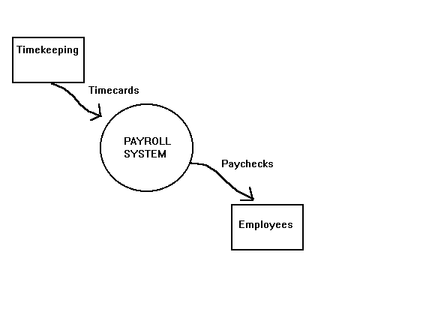
These slides are designed to accompany Software Engineering: A Practitioner’s Approach, 7/e (McGraw-Hill 2009). Slides copyright 2009 by Roger Pressman.

Slide 16
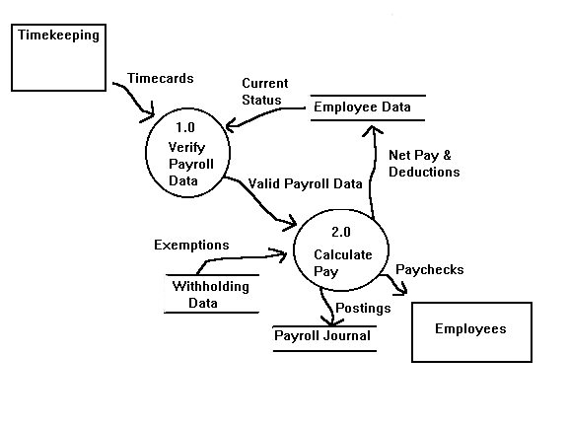

These slides are designed to accompany Software Engineering: A Practitioner’s Approach, 7/e (McGraw-Hill 2009). Slides copyright 2009 by Roger Pressman.

Slide 17
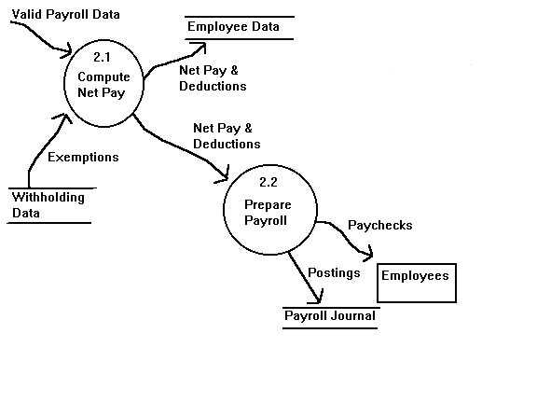
These slides are designed to accompany Software Engineering: A Practitioner’s Approach, 7/e (McGraw-Hill 2009). Slides copyright 2009 by Roger Pressman.

Slide 18
Process Specification (PSPEC)
bubble
PSPEC
narrative
pseudocode (PDL)
equations
tables
diagrams and/or charts
These slides are designed to accompany Software Engineering: A Practitioner’s Approach, 7/e (McGraw-Hill 2009). Slides copyright 2009 by Roger Pressman.

Slide 19
DFDs: A Look Ahead
analysis model
Maps into
design model
These slides are designed to accompany Software Engineering: A Practitioner’s Approach, 7/e (McGraw-Hill 2009). Slides copyright 2009 by Roger Pressman.

Slide 20
Control Flow Modeling
Represents “events” and the processes that manage events
An “event” is a Boolean condition that can be ascertained by:
    listing all sensors that are "read" by the software.
    listing all interrupt conditions.
    listing all "switches" that are actuated by an operator.
    listing all data conditions.
    recalling the noun/verb parse that was applied to the processing narrative, review all "control items" as possible CSPEC inputs/outputs.
These slides are designed to accompany Software Engineering: A Practitioner’s Approach, 7/e (McGraw-Hill 2009). Slides copyright 2009 by Roger Pressman.

Slide 21
Control Specification (CSPEC)
The CSPEC can be:
state diagram
(sequential spec)
state transition table
combinatorial spec
decision tables
activation tables
These slides are designed to accompany Software Engineering: A Practitioner’s Approach, 7/e (McGraw-Hill 2009). Slides copyright 2009 by Roger Pressman.

Slide 22
Behavioral Modeling
The behavioral model indicates how software will respond to external events or stimuli. To create the model, the analyst must perform the following steps:
    Evaluate all use-cases to fully understand the sequence of interaction within the system.
    Identify events that drive the interaction sequence and understand how these events relate to specific objects.
    Create a sequence for each use-case.
    Build a state diagram for the system.
    Review the behavioral model to verify accuracy and consistency.
These slides are designed to accompany Software Engineering: A Practitioner’s Approach, 7/e (McGraw-Hill 2009). Slides copyright 2009 by Roger Pressman.

Slide 23
State Representations
In the context of behavioral modeling, two different characterizations of states must be considered:
  the state of each class as the system performs its function and
  the state of the system as observed from the outside as the system performs its function
The state of a class takes on both passive and active characteristics [CHA93].
  A passive state is simply the current status of all of an object’s attributes.
  The active state of an object indicates the current status of the object as it undergoes a continuing transformation or processing.
These slides are designed to accompany Software Engineering: A Practitioner’s Approach, 7/e (McGraw-Hill 2009). Slides copyright 2009 by Roger Pressman.

Slide 24
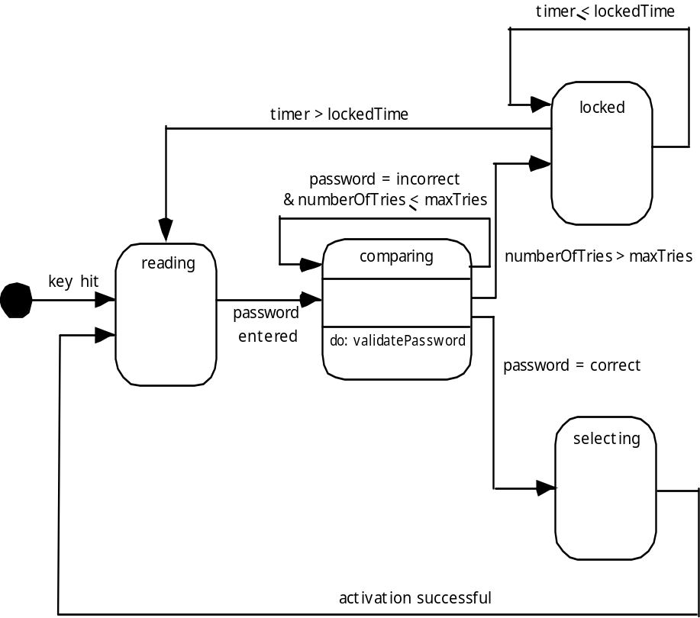
State Diagram for the ControlPanel Class
These slides are designed to accompany Software Engineering: A Practitioner’s Approach, 7/e (McGraw-Hill 2009). Slides copyright 2009 by Roger Pressman.

Slide 25
The States of a System
state—a set of observable circum-stances that characterizes the behavior of a system at a given time
state transition—the movement from one state to another
event—an occurrence that causes the system to exhibit some predictable form of behavior
action—process that occurs as a consequence of making a transition
These slides are designed to accompany Software Engineering: A Practitioner’s Approach, 7/e (McGraw-Hill 2009). Slides copyright 2009 by Roger Pressman.

Slide 26
Behavioral Modeling
make a list of the different states of a system (How does the system behave?)
indicate how the system makes a transition from one state to another (How does the system change state?)
  indicate event
  indicate action
draw a state diagram or a sequence diagram
These slides are designed to accompany Software Engineering: A Practitioner’s Approach, 7/e (McGraw-Hill 2009). Slides copyright 2009 by Roger Pressman.

Slide 27
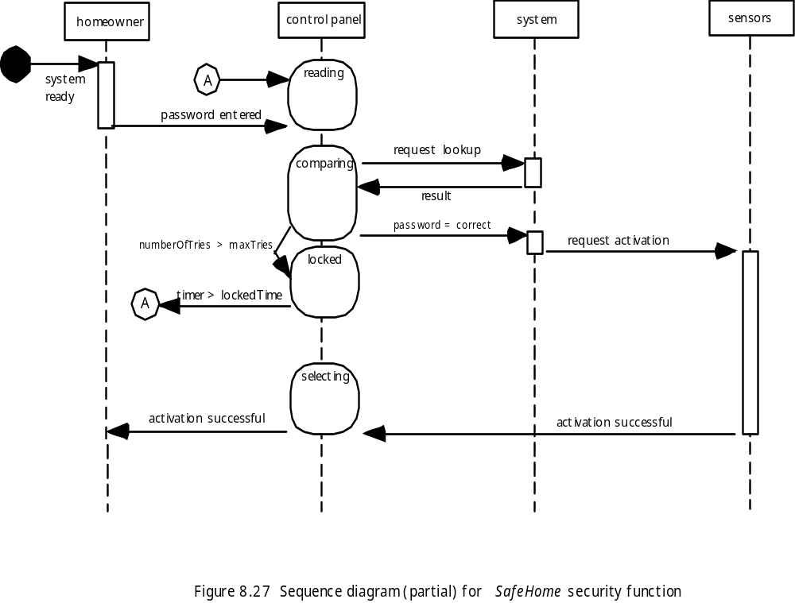
Sequence Diagram
These slides are designed to accompany Software Engineering: A Practitioner’s Approach, 7/e (McGraw-Hill 2009). Slides copyright 2009 by Roger Pressman.

Slide 28
Writing the Software Specification
Everyone knew exactly what had to be done until someone wrote it down!
These slides are designed to accompany Software Engineering: A Practitioner’s Approach, 7/e (McGraw-Hill 2009). Slides copyright 2009 by Roger Pressman.

Slide 29
Patterns for Requirements Modeling
Software patterns are a mechanism for capturing domain knowledge in a way that allows it to be reapplied when a new problem is encountered
  domain knowledge can be applied to a new problem within the same application domain
  the domain knowledge captured by a pattern can be applied by analogy to a completely different application domain.
The original author of an analysis pattern does not “create” the pattern, but rather, discovers it as requirements engineering work is being conducted.
Once the pattern has been discovered, it is documented
These slides are designed to accompany Software Engineering: A Practitioner’s Approach, 7/e (McGraw-Hill 2009). Slides copyright 2009 by Roger Pressman.

Slide 30
Discovering Analysis Patterns
The most basic element in the description of a requirements model is the use case.
A coherent set of use cases may serve as the basis for discovering one or more analysis patterns.
A semantic analysis pattern (SAP) “is a pattern that describes a small set of coherent use cases that together describe a basic generic application.” [Fer00]
These slides are designed to accompany Software Engineering: A Practitioner’s Approach, 7/e (McGraw-Hill 2009). Slides copyright 2009 by Roger Pressman.

Slide 31
An Example
Consider the following preliminary use case for software required to control and monitor a real-view camera and proximity sensor for an automobile:
    Use case: Monitor reverse motion
    Description: When the vehicle is placed in reverse gear, the control software enables a video feed from a rear-placed video camera to the dashboard display. The control software superimposes a variety of distance and orientation lines on the dashboard display so that the vehicle operator can maintain orientation as the vehicle moves in reverse. The control software also monitors a proximity sensor to determine whether an object is inside 10 feet of the rear of the vehicle. It will automatically break the vehicle if the proximity sensor indicates an object within 3 feet of the rear of the vehicle.
These slides are designed to accompany Software Engineering: A Practitioner’s Approach, 7/e (McGraw-Hill 2009). Slides copyright 2009 by Roger Pressman.

Slide 32
The Interaction Model
Composed of four elements:
  use-cases
  sequence diagrams
  state diagrams
  a user interface prototype
Each of these is an important UML notation and is described in Appendix I
These slides are designed to accompany Software Engineering: A Practitioner’s Approach, 7/e (McGraw-Hill 2009). Slides copyright 2009 by Roger Pressman.

Slide 33
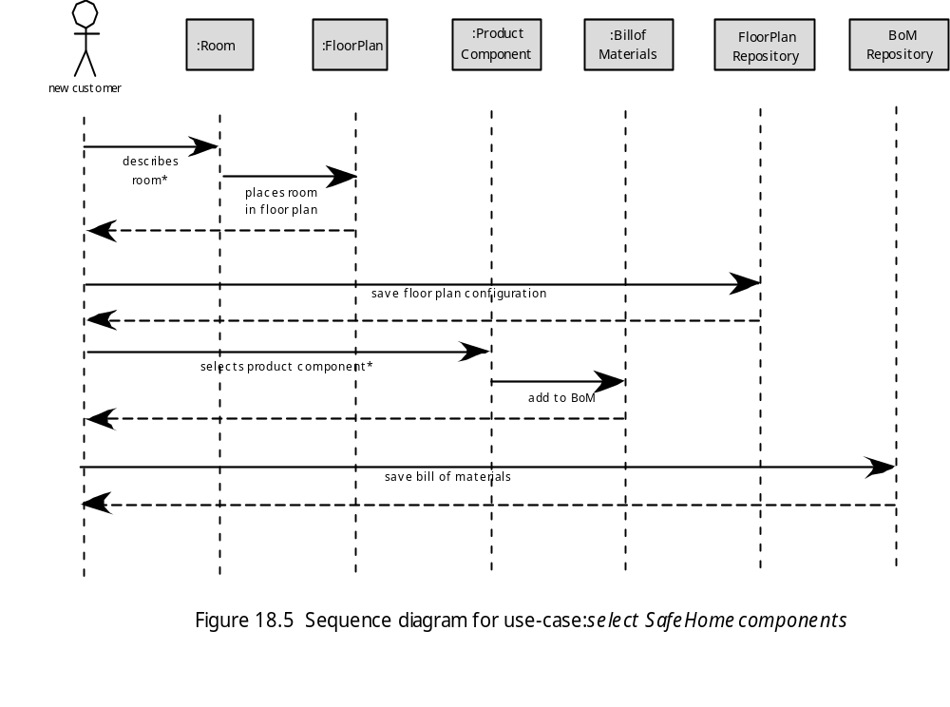
Sequence Diagram
These slides are designed to accompany Software Engineering: A Practitioner’s Approach, 7/e (McGraw-Hill 2009). Slides copyright 2009 by Roger Pressman.

Slide 34
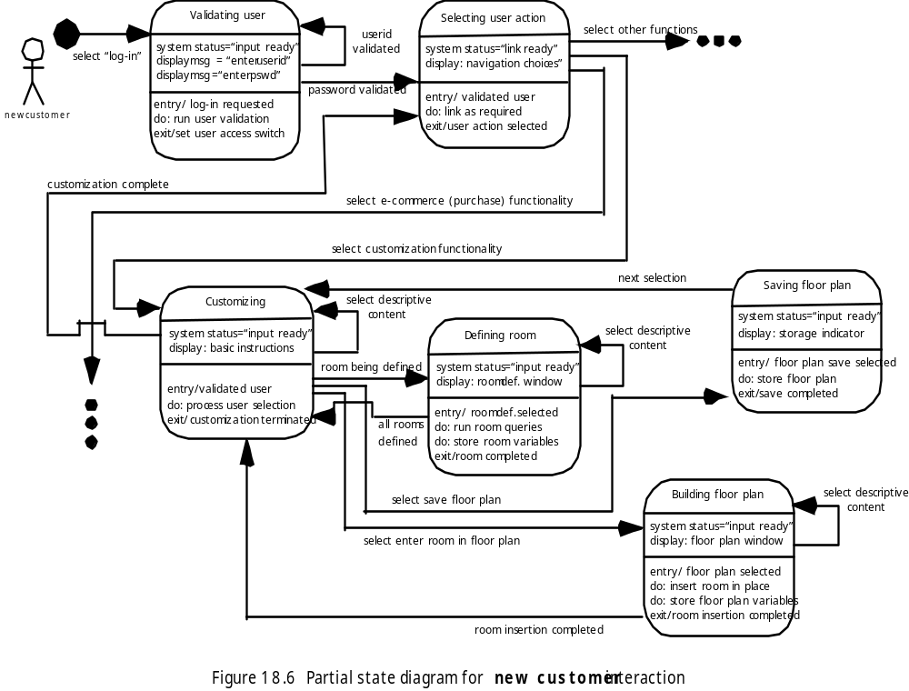
State Diagram
These slides are designed to accompany Software Engineering: A Practitioner’s Approach, 7/e (McGraw-Hill 2009). Slides copyright 2009 by Roger Pressman.

Slide 35
The Functional Model
The functional model addresses two processing elements of the WebApp
  user observable functionality that is delivered by the WebApp to end-users
  the operations contained within analysis classes that implement behaviors associated with the class.
An activity diagram can be used to represent processing flow
These slides are designed to accompany Software Engineering: A Practitioner’s Approach, 7/e (McGraw-Hill 2009). Slides copyright 2009 by Roger Pressman.

Slide 36
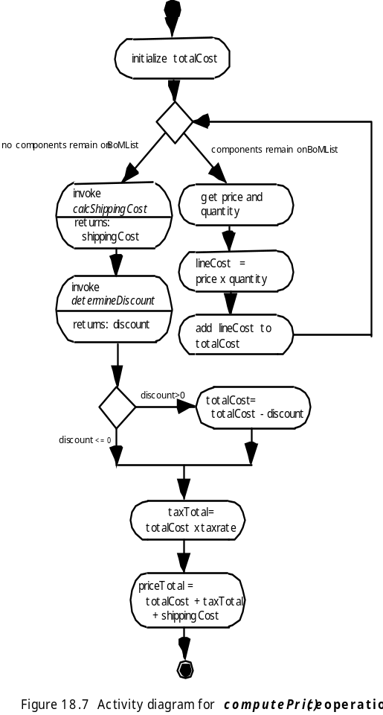
Activity Diagram
These slides are designed to accompany Software Engineering: A Practitioner’s Approach, 7/e (McGraw-Hill 2009). Slides copyright 2009 by Roger Pressman.

Slide 37
The Configuration Model
Server-side
  Server hardware and operating system environment must be specified
  Interoperability considerations on the server-side must be considered
  Appropriate interfaces, communication protocols and related collaborative information must be specified
Client-side
  Browser configuration issues must be identified
  Testing requirements should be defined
These slides are designed to accompany Software Engineering: A Practitioner’s Approach, 7/e (McGraw-Hill 2009). Slides copyright 2009 by Roger Pressman.

